Slide 1
Flight Into Egypt
Henry Tanner

Slide 2
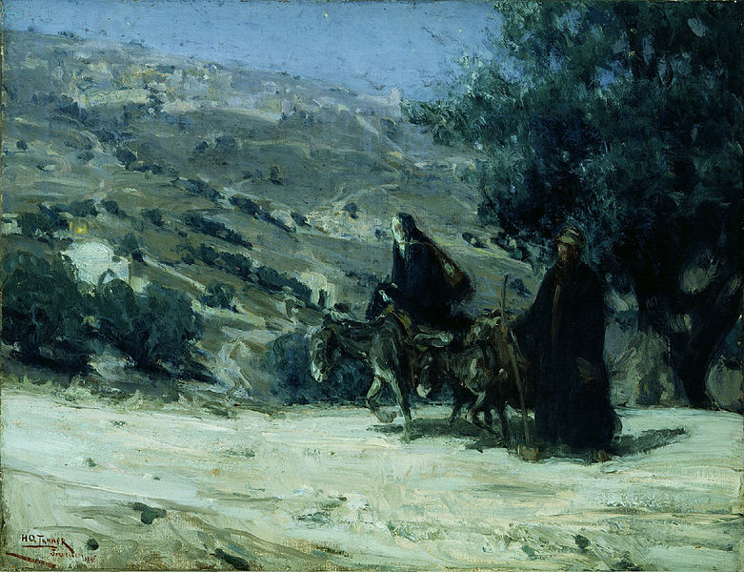

Slide 3
Outline
Flight into Egypt is a reflection of the challenges one can face during a forced migration. It was selected by the artist because it represented the slavery period faced by Africans in the 17th-19th centuries.
This painting focuses on the theme of personal liberty. Just as Mary and Joseph were fleeing from oppression, Tanner urges Africans to free themselves from oppression.
As an artist, Tanner focuses on human feelings within a spiritual context. He was the most famous African-American artist of the 19th century and depicted black people in more humane ways than other artists of the time.

Slide 4
Outline (II)
This painting addresses the portrayal of life as an African during that period, where it usually involved oppression and attempts to find personal liberty.
The theme of rebirth in this painting reflects the topics of revival and migration which were regularly discussed in black churches of the time.
Tanner used this painting to show Africans that it was possible to be sustained by personal faith even when the situation is extremely difficult.

